Slide 1
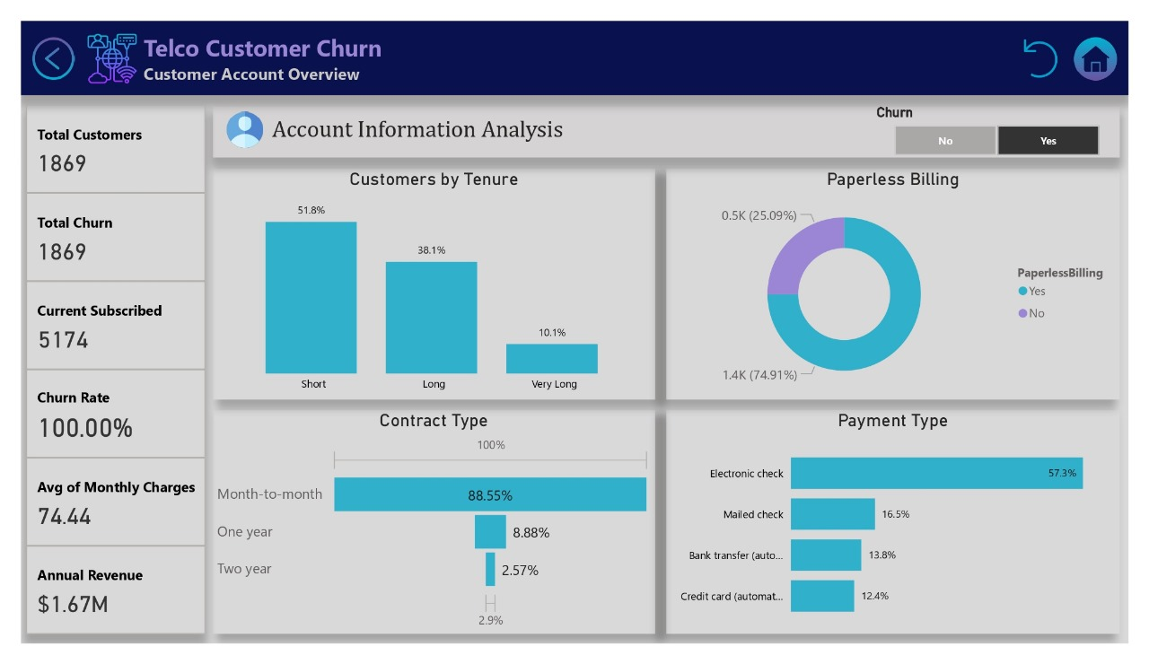

Slide 2


Presented by NTI Team
Telco Customer
Churn Analysis
Analyzing customers churn in the telecommunications industry

Slide 3

TABLE OF CONTENTS
1
Introduction and Overview
2
Our team
3
Cleaning & Transformation
4
EDA & Key Insights
5
Overview Dashboards
6
Conclusion & Recommendations

Slide 4

INTRODUCTION
● This project analyzes customer churn in the telecom industry
● focusing on demographics and account details of high-risk customers to identify churn factors.
()( The Goal )()
The project Aims to support data-driven decisions for improving customer retention

Slide 5

Objectives
● Analyze customer churn data
to Identify key churn factors
●Visualize churn rates
●Provide insights and
recommendations to reduce churn

Slide 6








THE TEAM
Rahma Ehab
Ahmed Nassar
Mai Mamdooh
Esraa Eleraky
Merhan Mahmoud
Maher Mahmoud

Slide 7

About
The Dataset

Slide 8

About the Dataset
The dataset used is kaggle publicly available
and contains information on customers :
• Demographics:
Gender, senior citizen status, partner status, and dependents.
• Account Information:
Contract type, payment method, and monthly charges.
• Services:
Internet service, online security, device protection, and more..

Slide 9

Columns Description: (21 columns)
N | Column Name | Description
1 | customerID | A unique identifier for each customer
2 | gender | The gender of the customer (Male or Female)
3 | SeniorCitizen | Indicates whether the customer is a senior citizen (1 = Yes, 0 = No)
4 | Partner | Indicates whether the customer has a partner (Yes or No)
5 | Dependents | Indicates whether the customer has dependents (Yes or No)
6 | tenure | The number of months the customer has stayed with the company
7 | PhoneService | Indicates whether the customer has a phone service (Yes or No)
8 | MultipleLines | Indicates whether the customer has multiple phone lines (Yes, No, ..)
9 | InternetService | The type of internet service the customer has (DSL, Fiber optic, or ..)
10 | OnlineSecurity | Indicates whether the customer has online security service (Yes, No, ..)
11 | OnlineBackup | Indicates whether the customer has an online backup service (Yes, No, ..)
12 | DeviceProtection | Indicates whether the customer has a device protection service (Yes, No, or ..)

Slide 10
Columns Description: (21 columns)
N | Column Name | Description
13 | TechSupport | Indicates whether the customer has tech support service (Yes, No, or ..)
14 | StreamingTV | Indicates whether the customer has a streaming TV service (Yes, No, or ..)
15 | StreamingMovies | Indicates whether the customer has streaming movies service (Yes, No, or ..)
16 | Contract | The type of contract the customer has (Month-to-month, One year, Two years)
17 | PaperlessBilling | Indicates whether the customer uses paperless billing (Yes or No)
18 | PaymentMethod | The payment method used by the customer (Bank, Credit, electronic check, ..)
19 | MonthlyCharges | The monthly charges paid by the customer
20 | TotalCharges | The total charges paid by the customer to date
21 | Churn | Indicates whether the customer has churned (left the company) (Yes or No)

Slide 11
Cleaning &
Transformation

Slide 12
Cleaning & Transformation
LARANA COMPANY
• Our dataset consisted of a total of 7043 rows and 21 columns .
• Our data is found in clean form.
• Our dataset looks a bit tidy with no NaNs nor duplicated values.
• TotalCharges column has null values that need to be handled, it has 11 nulls,
and we replaced them by zero After finding that tenure values equal to zero
• SeniorCitizen column Replaced [0] by [younger] and replaced [1] by [older].
• Added Conditional Column tenure category (1:10 [Short], 11:50 [Long], >50 [Very Long])
• No columns needed to be dropped.

Slide 13
EDA
Questions

Slide 14

EDA Questions :-
Q1: How many customers have subscribed to date?
Q2: How many have unsubscribed from our services?
Q3: What is the number of current customers?
Q4: What is the churn rate?
Q5: What is the average charges per month?
Q6: What is the annual revenue?

Slide 15

EDA Questions :-
Q7: What is the sum of Monthly Charges per Internet Service?
Q8: What is the number of subscribed and unsubscribed customers per their demographic information?
Q9: What are services the subscribed and unsubscribed customers were using?
Q10: What is the number of subscribed and unsubscribed customers
per their account information?
Q11: What is tenure distribution of the existing customer?
Q12: Which factors have the strongest correlation with churn?

Slide 16
EDA & Insights
in Python

Slide 17
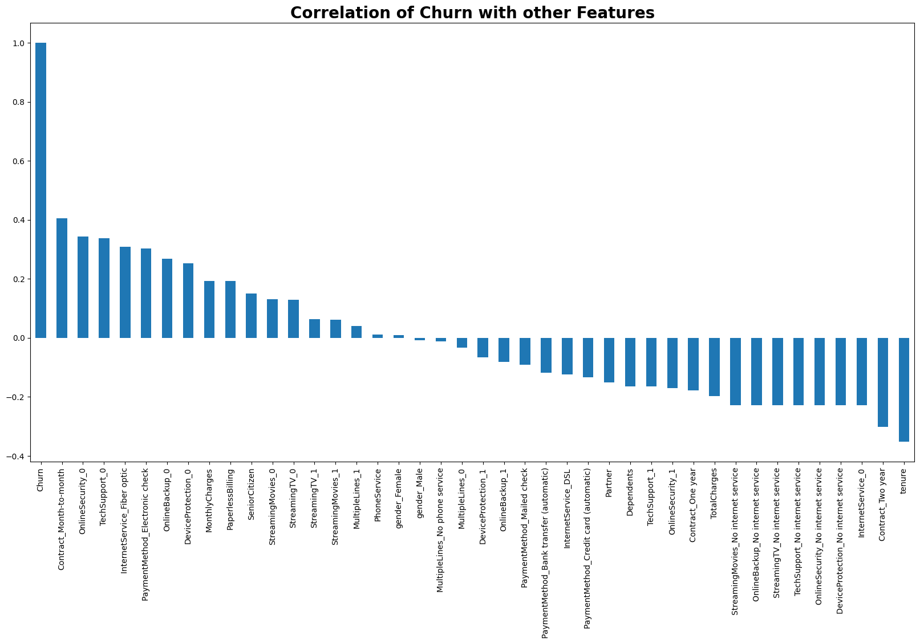
● Some correlations got found

Slide 18
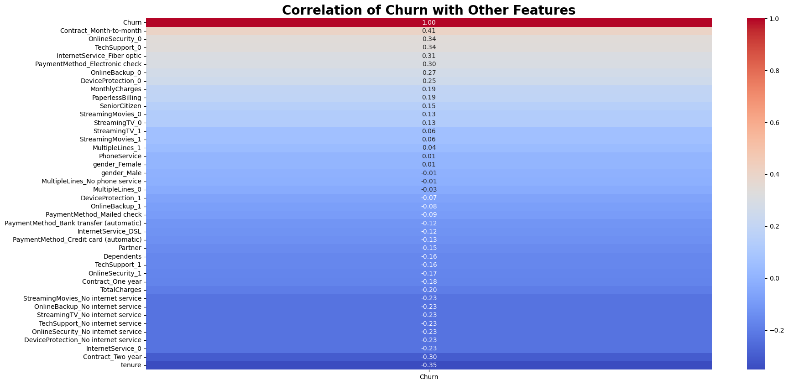
Correlations
● Positive Correlations with Churn:
- `Month-to-month` contract
- `online security` & `Tech Support` and `Fiber obtic`
** These Customers are more likely to churn.**
● Negative Correlations
- `two-year` contracts
`tenure` & Other Servies Like `online security`,
`streaming TV`, `online backup`, and `tech support`
**customers with these services are less likely to churn.**
● No Correlations with:
- `Gender` & `Phone Services` and `Multi Lines`

Slide 19
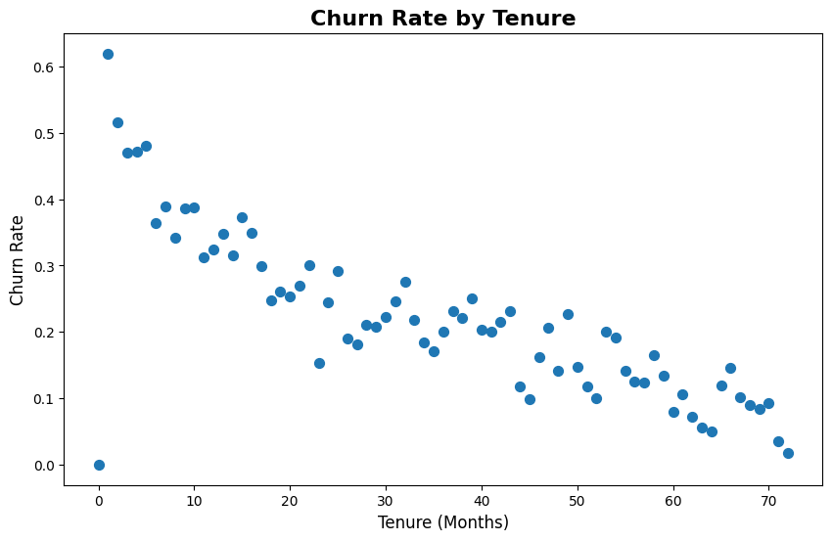

● Customers with shorter tenures, especially within the first 10 months,
have a higher churn rate, highlighting the importance of focusing on retention strategies during this critical initial period.
● Customer retention improves over time, emphasizing the need to engage and support
new customers early to reduce churn and enhance long-term loyalty.

Slide 20
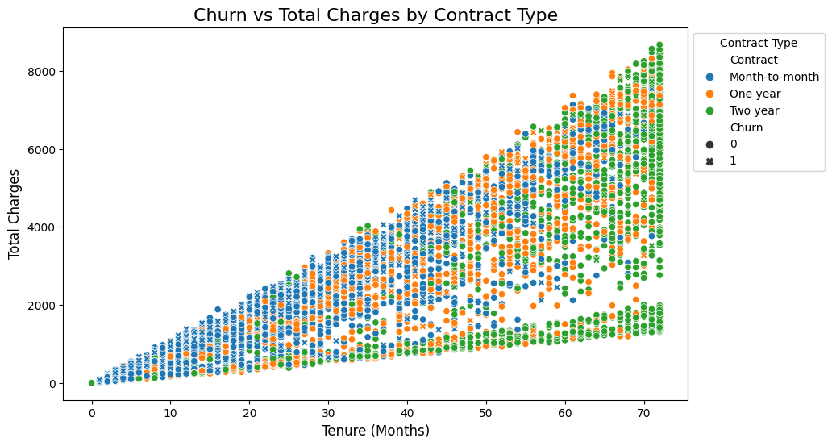

● It's logical that Total Charges increase as the Tenure increase.
● But it seems that there is no realtion between Total Charges and Churns rate.

Slide 21
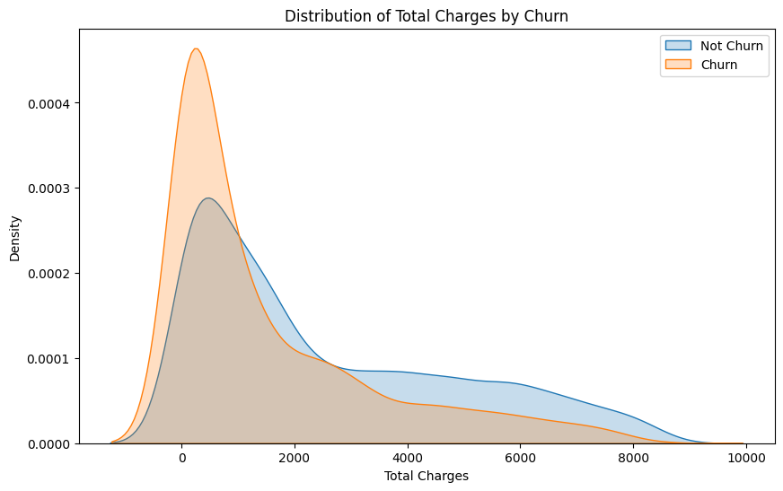
● Higher churn when the total charges are lower.

Slide 22
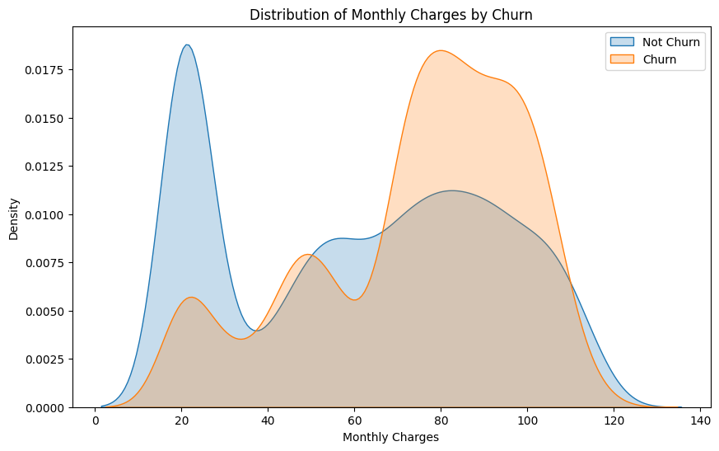
● Higher customers churn when the monthly charges are high.
● We have successfully extracted the churn correlation with other feature.
Now, we would like to take a quick look at the overall company performance.

Slide 23
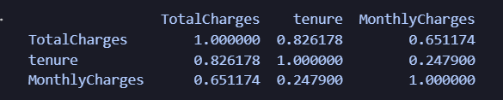
Correlations
● TotalCharges and tenure: Correlation = 0.8 → Strong relationship
(but not 100%, which means there might be other factors influencing TotalCharges)
● TotalCharges and MonthlyCharges: Correlation = 0.6 → Moderate relationship,
meaning TotalCharges does not solely depend on MonthlyCharges.
● tenure and MonthlyCharges: Correlation = 0.2 → Weak relationship,
indicating that the duration a customer has stayed does not strongly correlate.

Slide 24
Visualization
& Key Insights

Slide 25

Main 3 Key Insights
Customer Account Overview
Demographics Overview
Services Overview

Slide 26
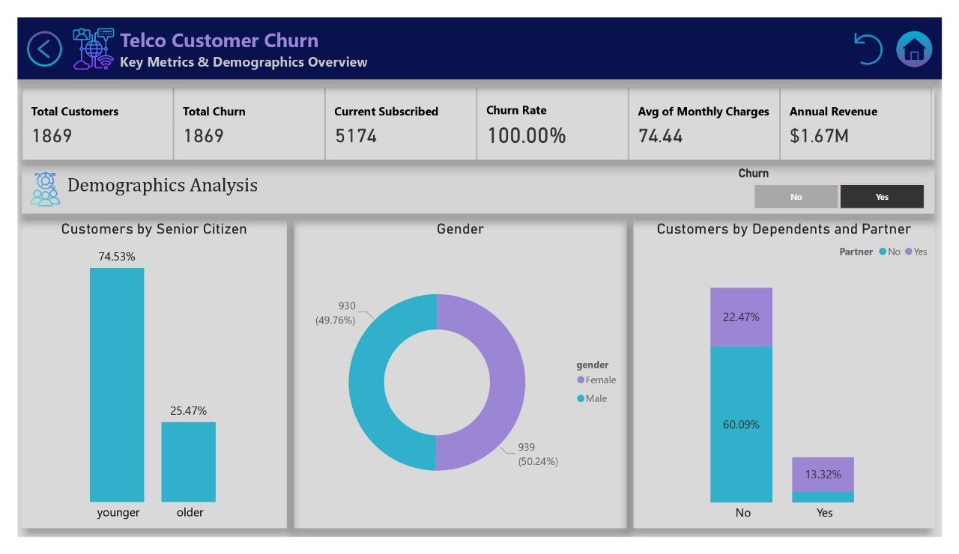

Slide 27
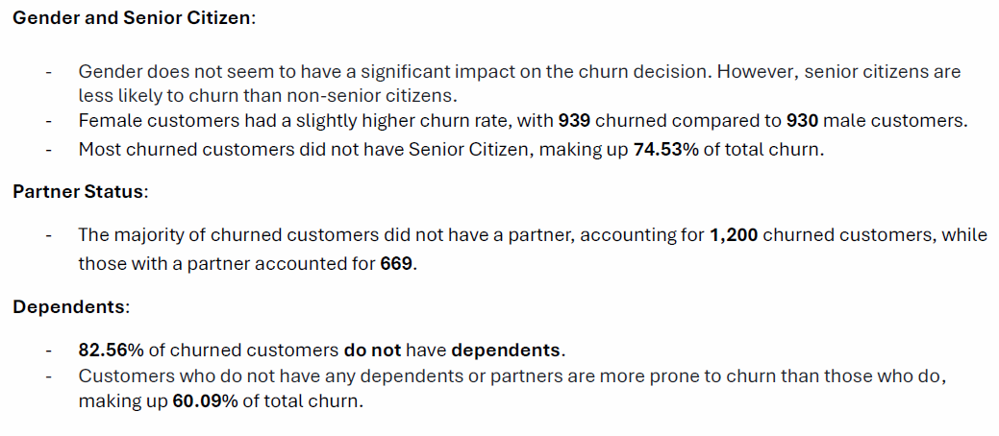
● Demographics Overview

Slide 28
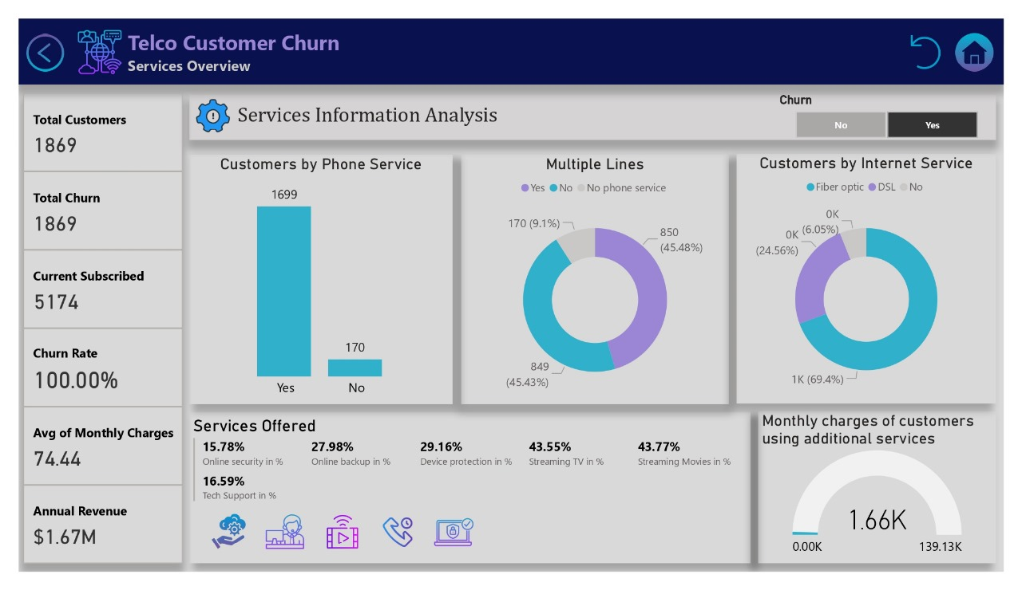

Slide 29
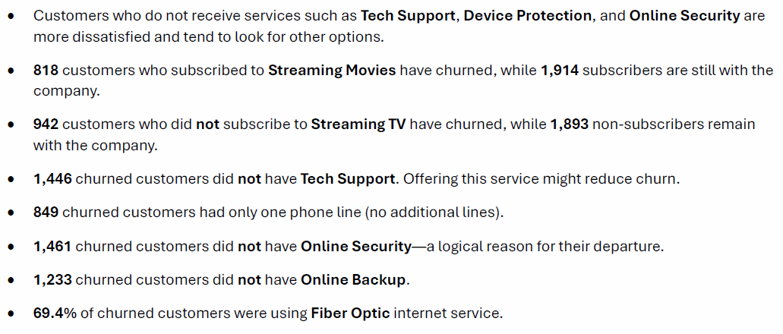
● Services Overview

Slide 31
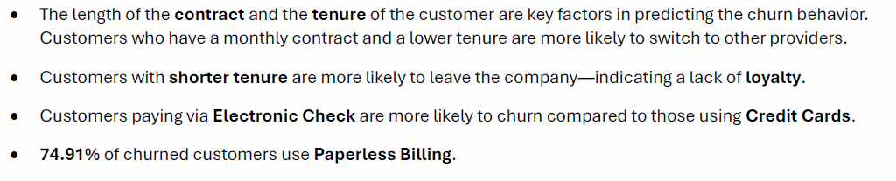

● Customer Account Overview

Slide 32
CONCLUSIONS

Slide 33

CONCLUSIONS
● Churn Rate:
The company has a churn rate in the company of 26.5%,
with 1,869 out of 7,043 customers at risk.
The total annual revenue stands at $5.47M.
● High Churn Among Month-to-Month Contracts:
Month-to-month Customers have a higher churn rate
compared to those with longer-term contracts,
indicating that month-to-month customers may have less loyalty.
● Dependents and Stability:
customers without partners or dependents have higher churn rates, highlighting a potential need for targeted retention efforts.

Slide 34
CONCLUSIONS
● Impact of Internet Service Type:
Customers using fiber optic internet have a higher churn rate,
which could point to service quality or pricing issues
with this type of connection.
● No Add-Ons:
Most churned customers did not subscribe to additional services
like online security and tech support,
suggesting that bundled services could improve retention.
● High-Risk Payment Methods:
Customers using electronic checks show a higher churn rate,
which could suggest dissatisfaction with billing methods

Slide 35
Recommendations

Slide 36
Recommendations
● Enhance Retention Among Senior Citizens:
Develop loyalty programs or personalized offers targeting senior citizens
to increase engagement and reduce churn in this demographic.
● Promote Longer-Term Contracts:
Consider offering discounts or incentives for customers to switch from month-to-month to longer-term contracts. Highlighting the value and savings.
● Focus on Payment Method Options:
Since electronic check users have a higher churn rate, consider educate them on more secure or convenient payment options like bank transfers or credit card.
Additionally, offering incentives for switching payment methods.

Slide 37
Recommendations
● Engage Paperless Billing Customers:
Introduce customer engagement programs specifically for paperless billing users. This could involve sending personalized communications, offering exclusive deals, or educating them about additional services.
● Optimize Service Quality for Internet Customers:
Fiber optic users show a higher churn rate than DSL users. Investing in improving fiber optic service quality.

Slide 38

THANK
YOU!

